Slide 1
What to Know About Plug-In Vehicles
Charlie Johnson
CEO & Ethical Energy Efficiency Expert
(760) 809-3391
charlie@makello.com

Slide 2
The Energy Ecosystem
Solar Panels, Plug-In Vehicles & Energy Storage

Slide 3
Why Do We Care About Plug-In Vehicles?
Economics.
Energy Independence.
Lifestyle.
Status.
Environment.
Health.
Safety.

Slide 4
Economics - Utility Rates
The old way:
Tiered Rates
The new way:
Time-Of-Use
EV Time-Of-Use

Slide 5
Economics - Electric vs Gas
Electric
Solar power at $0.06/kWh - $0.08/kWh ~= $200/yr
EVTOU5 Super Off-Peak at $0.093/kWh ~= $500/yr*
EVTOU2 Super Off-Peak at $0.23/kWh ~= $700/yr
DRTOU1 Super Off-Peak at $0.35/kWh ave ~= $1,050/yr
DRTOU1 Off-Peak Rate at $0.4/kWh ave ~= $1,200/yr
DRTOU1 Peak Rate at $0.51/kWh ave ~= $1,530/yr
VS
GAS
Hybrid (40 MPG) ~= $1,200/yr
Sedan (25 MPG) ~= $1,900/yr
Truck (13 MPG) ~= $3,700/yr
*Includes $16/mo EVTOU5 Rate Fee
Assumptions: 12,000 miles/year. $4/gal. gas price. EV driving = 4 miles/kWh.

Slide 6
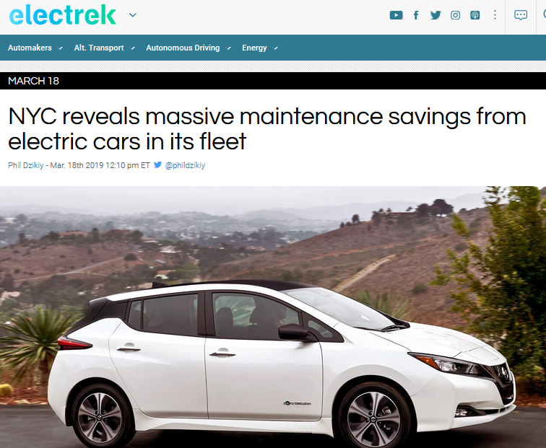
Economics - Maintenance
An EV saves about $1000 - $2000 / year in maintenance costs, vs similar ICE vehicle
Notes:
https://www.greencarreports.com/news/1123920_toyota-covers-prius-prime-with-solar-panels-to-test-mileage

Slide 7
Economics - Electric vs Gas
EVs may account for more than half of global car sales by 2040: BNEF
57% of all passenger car sales
Electric buses to account for 81%
Highest Per Capita EV penetration is in Santa Monica
Let’s look at a case study.

Slide 8
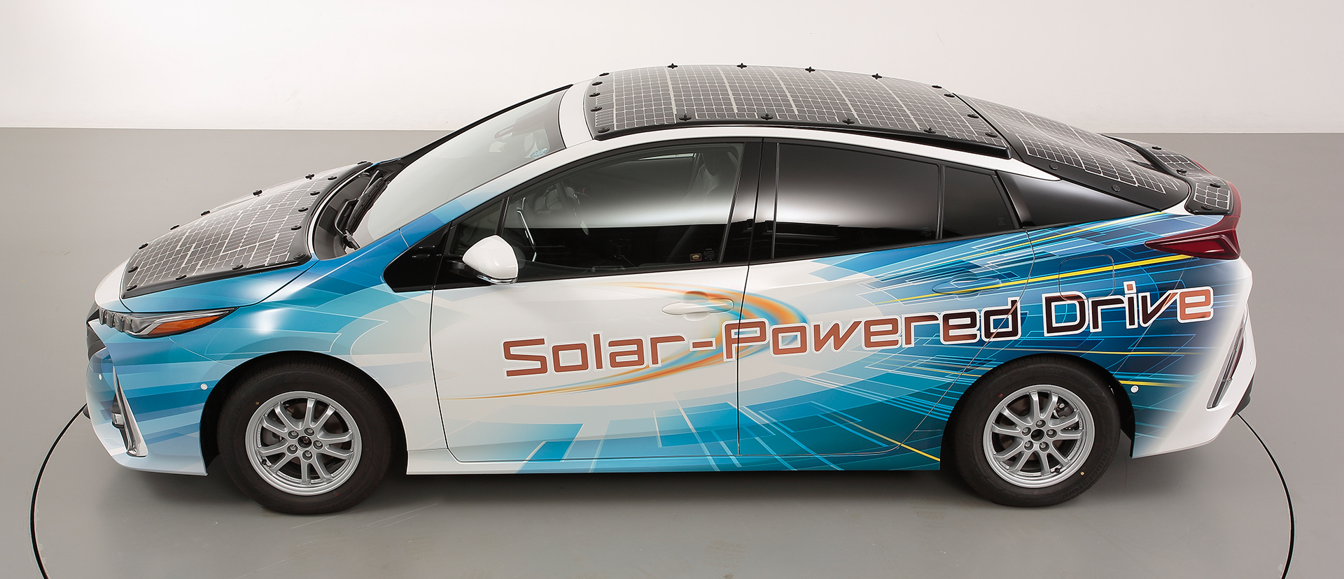
Solar Powered Plug-In Vehicles Are Coming Soon!
Toyota Prius PHV
34% efficient solar panels = 27.6 miles of electric power per day
Notes:
https://www.greencarreports.com/news/1123920_toyota-covers-prius-prime-with-solar-panels-to-test-mileage

Slide 9
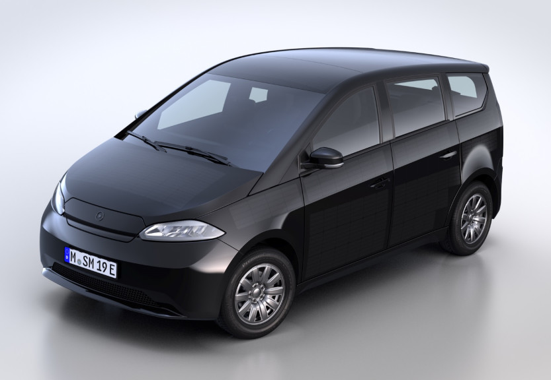
Solar Powered Plug-In Vehicles Are Coming Soon!
Sono Sion $28,702
155 mile EV range, 21 mile solar range per day
Notes:
https://sonomotors.com/en/sion/

Slide 10
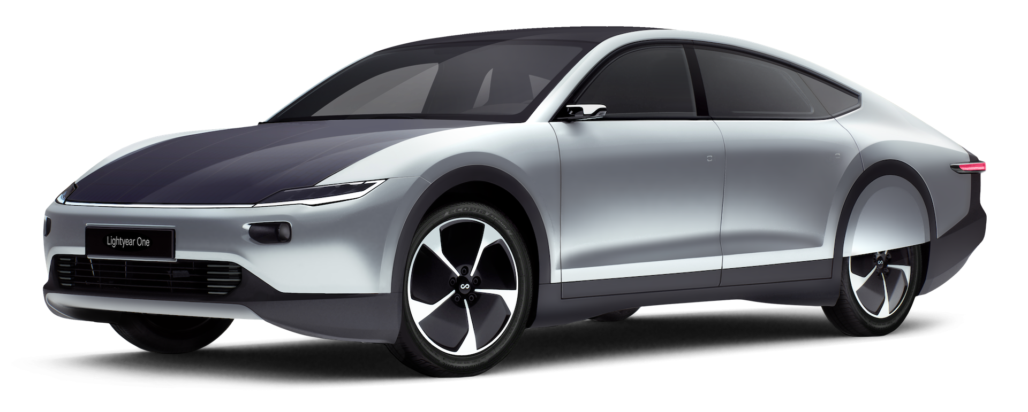
Solar Powered Plug-In Vehicles Are Coming Soon!
Lightyear One $167,720
450 mile EV range
Notes:
https://lightyear.one/lightyear-one/

Slide 11
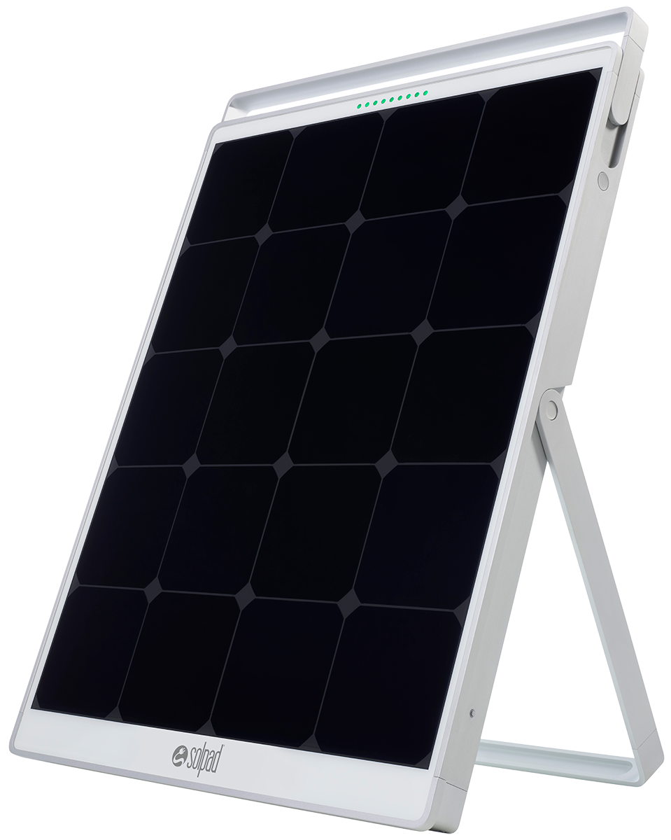
You Can Soon Charge Your EV with Portable Solar Panels!
Solpad
Notes:
https://solpad.com/

Slide 12
These Amazing Plug-In Vehicles Are Coming Soon!
MINI Electric $35,000
146 mile EV range, 184 HP
Notes:
https://www.theverge.com/2019/7/9/20687413/bmw-electric-mini-cooper-specs-release

Slide 13
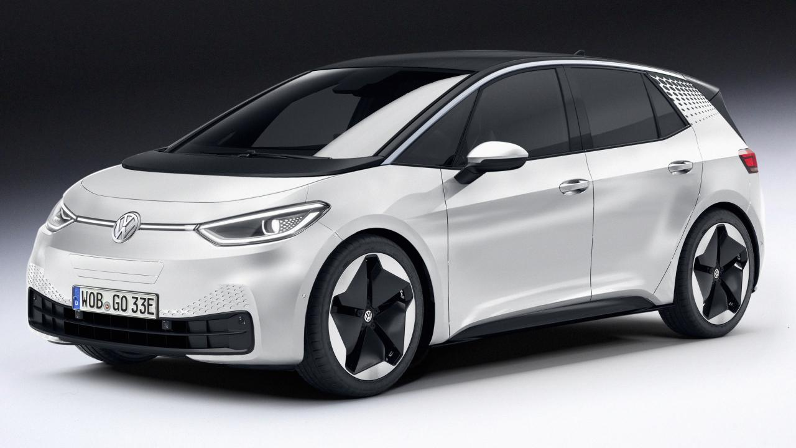
These Amazing Plug-In Vehicles Are Coming Soon!
Volkswagen ID. 3 $33,776
342 mile EV range, 134 HP
Notes:
https://electrek.co/2019/05/08/vw-id3-specs-electric-hatchback-range/
https://ev-database.org/car/1127/Volkswagen-ID3-Standard-Range

Slide 14
These Amazing Plug-In Vehicles Are Coming Soon!
Honda e $33,776
124 mile EV range, 148 HP
Notes:
https://ev-database.org/car/1171/Honda-e

Slide 15
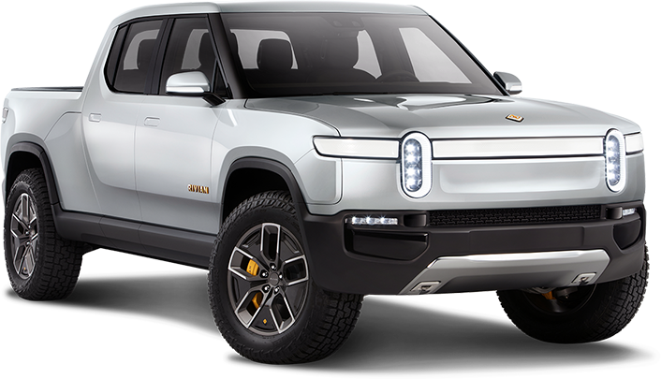
These Amazing Plug-In Vehicles Are Coming Soon!
Rivian R1T $69,000
400+ mile EV range, 750 HP
Notes:
https://products.rivian.com/

Slide 16
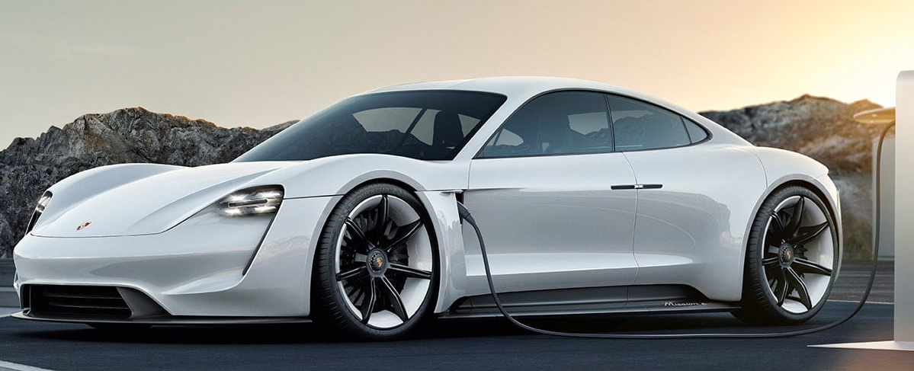
These Amazing Plug-In Vehicles Are Coming Soon!
Porsche Taycan $75,000
300+ mile EV range, 600 HP
Notes:
https://www.engadget.com/2018/12/28/porsche-taycan-ev-prices/?guccounter=1&guce_referrer=aHR0cHM6Ly93d3cuZ29vZ2xlLmNvbS8&guce_referrer_sig=AQAAALCnlGnDHfy6U2D3Sbk-ZYeez_qB_UUUUpipEkFl5-AraHGZUxiFG0wBoL2lFOxXWv_c0BhgTvkJ1WUpOunVL0I_ckb1W4uNDsTKGhp-VET2QRjIByhuE62X_NhpFVeCMqg0mTQFQlaLuDuNjzIXNPAPChVsx6Q1cdXf4YHHAPWu
https://www.caranddriver.com/porsche/taycan

Slide 17
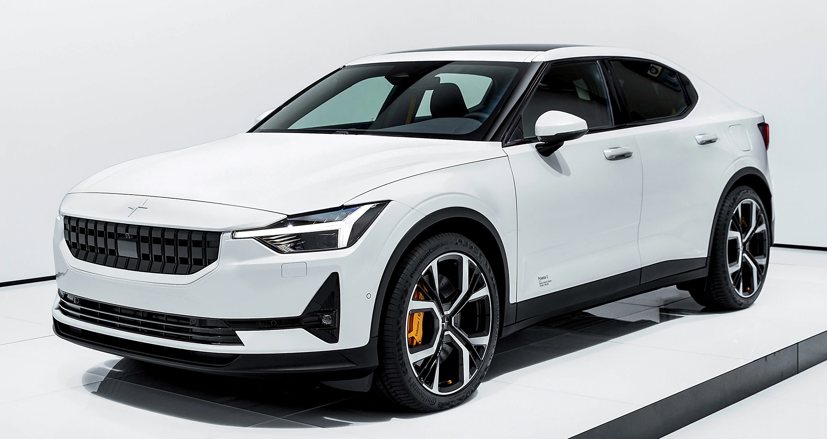
These Amazing Plug-In Vehicles Are Coming Soon!
Polestar 2 $55,000
275 mile EV range, 402 HP
Notes:
https://www.polestar.com/us/cars/polestar-2
https://www.cnet.com/roadshow/news/polestar-2-electric-car-pricing/

Slide 18
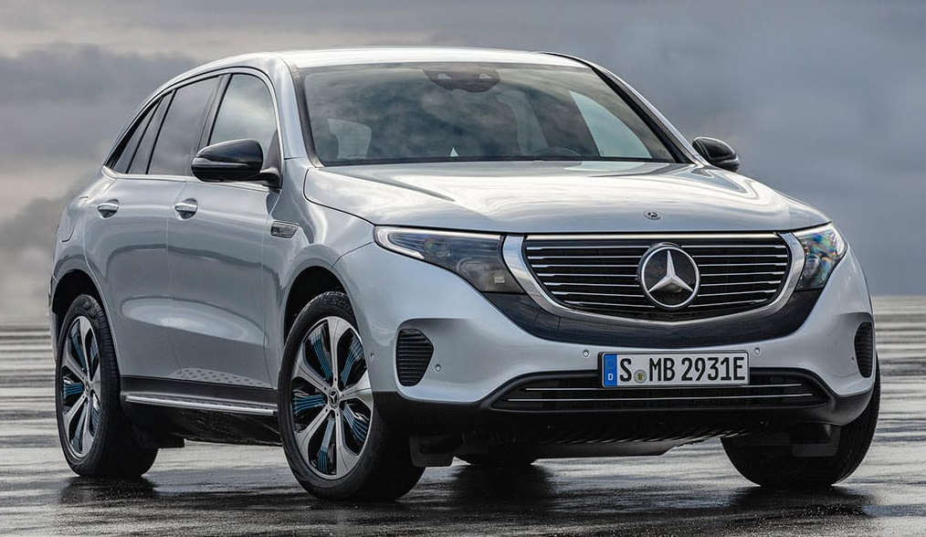
These Amazing Plug-In Vehicles Are Coming Soon!
Mercedes Benz EQC $80,000
279 mile EV range, 402 HP
Notes:
https://www.mbusa.com/en/future-vehicles/2020-eqc?sd_campaign_type=Search&sd_digadprov=Resolution&sd_campaign=Brand%7CCorp%7CFuture+Models%7CMB_Classes%7CGeneral%7CExact&sd_channel=GOOGLE&sd_adid=EQC&sd_digadkeyword=mercedes+eqc&gclid=EAIaIQobChMIsvuh0M6t4wIVBR-tBh2SvgCsEAAYASAAEgIq_fD_BwE&gclsrc=aw.ds

Slide 19
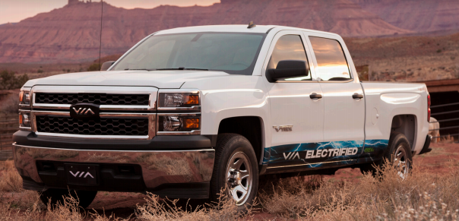
These Long-Range Plug-In Vehicles Are Available Now!
VIA VTRUX $79,000
40 mile EV range, 201 HP + Gas Engine
Notes:
https://www.mbusa.com/en/future-vehicles/2020-eqc?sd_campaign_type=Search&sd_digadprov=Resolution&sd_campaign=Brand%7CCorp%7CFuture+Models%7CMB_Classes%7CGeneral%7CExact&sd_channel=GOOGLE&sd_adid=EQC&sd_digadkeyword=mercedes+eqc&gclid=EAIaIQobChMIsvuh0M6t4wIVBR-tBh2SvgCsEAAYASAAEgIq_fD_BwE&gclsrc=aw.ds

Slide 20
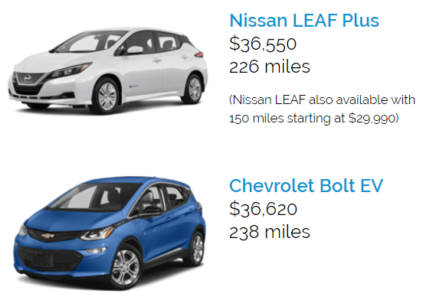
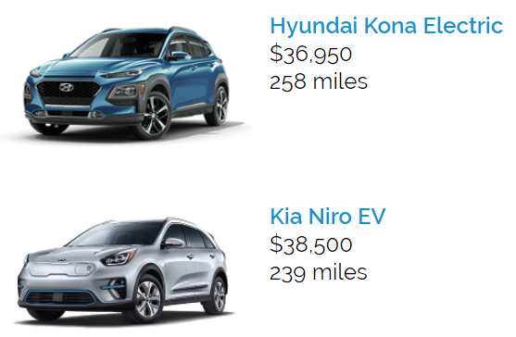
These Long-Range Plug-In Vehicles Are Available Now!
Notes:
https://www.mbusa.com/en/future-vehicles/2020-eqc?sd_campaign_type=Search&sd_digadprov=Resolution&sd_campaign=Brand%7CCorp%7CFuture+Models%7CMB_Classes%7CGeneral%7CExact&sd_channel=GOOGLE&sd_adid=EQC&sd_digadkeyword=mercedes+eqc&gclid=EAIaIQobChMIsvuh0M6t4wIVBR-tBh2SvgCsEAAYASAAEgIq_fD_BwE&gclsrc=aw.ds

Slide 21
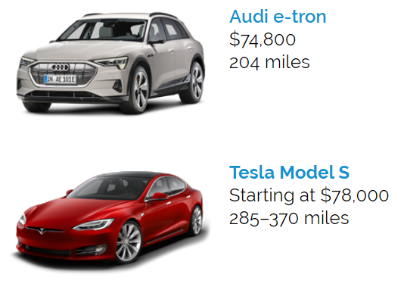
These Long-Range Plug-In Vehicles Are Available Now!
Notes:
https://www.mbusa.com/en/future-vehicles/2020-eqc?sd_campaign_type=Search&sd_digadprov=Resolution&sd_campaign=Brand%7CCorp%7CFuture+Models%7CMB_Classes%7CGeneral%7CExact&sd_channel=GOOGLE&sd_adid=EQC&sd_digadkeyword=mercedes+eqc&gclid=EAIaIQobChMIsvuh0M6t4wIVBR-tBh2SvgCsEAAYASAAEgIq_fD_BwE&gclsrc=aw.ds

Slide 22
Plug-In Vehicles Currently On Sale in the U.S.
Type | Brand | Model | Base Price (MSRP) | Price After Tax Credit | EPA EV Range (mi) | Total Range (mi) | Total HP
BEV | Audi | e-tron | $74,800 | $68,295 | 204 | 204 | 402
BEV | BMW | i3 | $44,450 | $37,945 | 153 | 153 | 168
BEV | BMW | i3s | $47,650 | $41,145 | 153 | 153 | 181
BEV | Chevrolet | Bolt EV | $36,620 | $33,745 | 238 | 238 | 201
BEV | Fiat | 500e | $32,995 | $26,790 | 84 | 84 | 111
BEV | Honda | Clarity Electric | Lease Only |  | 89 | 89 | 161
BEV | Hyundai | IONIQ Electric | $30,315 | $23,735 | 124 | 124 | 118
BEV | Hyundai | Kona Electric | $36,950 | $30,495 | 258 | 258 | 201
BEV | Jaguar | I-PACE | $69,500 | $63,025 | 234 | 234 | 394

Slide 23
Plug-In Vehicles Currently On Sale in the U.S.
Type | Brand | Model | Base Price (MSRP) | Price After Tax Credit | EPA EV Range (mi) | Total Range (mi) | Total HP
BEV | Kia | Niro EV (e-Niro) | $38,500 | $31,995 | 239 | 239 | 201
BEV | Kia | Soul EV | $33,950 | $27,445 | 111 | 111 | 109
BEV | Kia | Soul EV (e-Soul) |  |  | 243 | 243 | 201
BEV | Nissan | LEAF (40 kWh) | $29,990 | $23,375 | 150 | 150 | 148
BEV | Nissan | LEAF e+ S (62 kWh) | $36,550 | $29,945 | 226 | 226 | 215
BEV | Nissan | LEAF e+ SVISL (62 kWh) | $38,510 | $31,905 | 215 | 215 | 215
BEV | smart | EQ fortwo Coupe | $23,900 | $17,150 | 58 | 58 | 80
BEV | smart | EQ fortwo Cabrio | $28,100 | $21,350 | 57 | 57 | 80
BEV | Tesla | Model 3 Standard Range | $35,000 | $32,450 | 220 | 220 | 0

Slide 24
Plug-In Vehicles Currently On Sale in the U.S.
Type | Brand | Model | Base Price (MSRP) | Price After Tax Credit | EPA EV Range (mi) | Total Range (mi) | Total HP
BEV | Tesla | Model 3 Standard Range Plus | $39,500 | $36,950 | 240 | 240 | 0
BEV | Tesla | Model 3 Long Range RWD | $44,500 | $41,950 | 325 | 325 | 0
BEV | Tesla | Model 3 Long Range AWD | $49,500 | $46,950 | 310 | 310 | 0
BEV | Testa | Model 3 Performance LR AWD | $59,500 | $56,950 | 310 | 310 | 0
BEV | Tesla | Model S Standard Range | $78,000 | $75,450 | 285 | 285 | 0
BEV | Testa | Model S Long Range | $88,000 | $85,450 | 370 | 370 | 0
BEV | Tesla | Model S Performance | $99,000 | $96,450 | 345 | 345 | 0
BEV | Tesla | Model S Performance LM | $119,000 | $116,450 | 345 | 345 | 0

Slide 25
Plug-In Vehicles Currently On Sale in the U.S.
Type | Brand | Model | Base Price (MSRP) | Price After Tax Credit | EPA EV Range (mi) | Total Range (mi) | Total HP
BEV | Tesla | Model X Standard Range | $83,000 | $80,450 | 250 | 250 | 0
BEV | Tesla | Model X Long Range | $93,000 | $90,450 | 325 | 325 | 0
BEV | Testa | Model X Performance | $104,000 | $101,450 | 305 | 305 | 0
BEV | Testa | Model X Performance LM | $124,000 | $121,450 | 305 | 305 | 0
BEV | VW | e-Golf | $31,895 | $25,290 | 125 | 125 | 134
PHEV | Audi | A3 Sportback e-tron | $39,500 | $35,973 | 16 | 400 | 251
PHEV | BMW | 530e iPerformance | $53,400 | $49,727 | 16 | 370 | 278
PHEV | BMW | 530e xDrive iPerformance | $55,700 | $52,027 | 14 | 360 | 278

Slide 26
Plug-In Vehicles Currently On Sale in the U.S.
Type | Brand | Model | Base Price (MSRP) | Price After Tax Credit | EPA EV Range (mi) | Total Range (mi) | Total HP
PHEV | BMW | 740e xDrive iPerformance | $91,250 | $87,577 | 14 | 340 | 362
PHEV | BMW | 745e xDrive iPerformance | $95,550 | $90,709 | 16 | 290 | 505
PHEV | BMW | i3 REx | $48,300 | $41,795 | 126 | 200 | 202
PHEV | BMW | i3s REx | $51,500 | $44,995 | 126 | 200 | 215
PHEV | BMW | i8 Coupe | $147,500 | $142,826 | 17 | 320 | 369
PHEV | BMW | i8 Roadster | $163,300 | $158,626 | 17 | 320 | 369
PHEV | Cadillac | CT6 PHEV | $75,095 | $72,340 | 31 | 430 | 535
PHEV | Chevrolet | Volt | $33,220 | $30,345 | 53 | 420 | 250
PHEV | Chrysler | Pacifica Hybrid | $39,995 | $33,990 | 32 | 520 | 367

Slide 27
Used Plug-In Vehicles Are Affordable
Used Plug-In vehicles are even more affordable to purchase or finance.
55% depreciation in 3 years for new Luxury vehicles.
35% depreciation in 3 years for new Economy vehicles.
8 - 10 year warranty on traction batteries
2nd life for home battery backup or recycling.
So let’s take a look at various options of used Plug-In Vehicles available today.

Slide 28
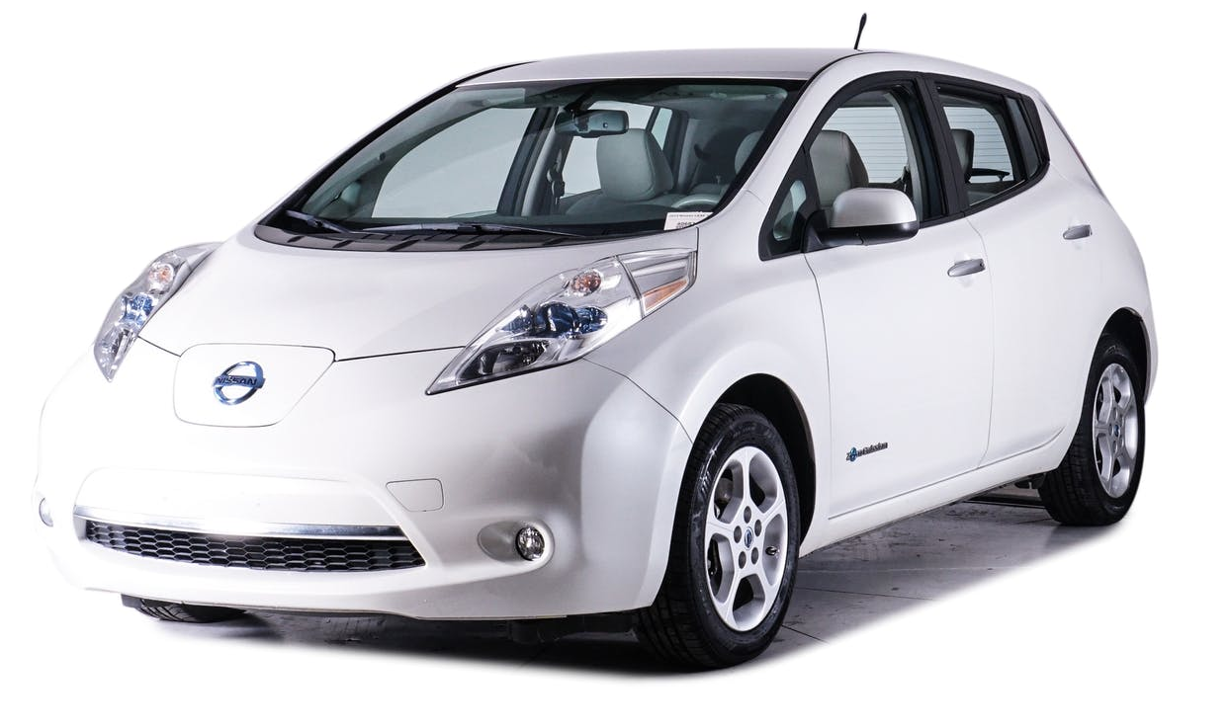
Used Plug-In Vehicles Are Affordable
2013 Nissan LEAF SV $5,400
Mileage: 70,822 miles or $94/mo (72 mo @ 7.74%)
75 mile EV range, 107 HP

Slide 29
Used Plug-In Vehicles Are Affordable
2013 FIAT 500e $6,950 Mileage: 27,911 miles or $121/mo (72 mo @ 7.74%)
87 mile EV range, 111 HP

Slide 30
Used Plug-In Vehicles Are Affordable
2012 Mitsubishi i-MIEV SE $7,599 Mileage: 45,000 miles or $132/mo (72 mo @ 7.74%)
62 mile EV range, 66 HP

Slide 31
Used Plug-In Vehicles Are Affordable
2012 Toyota Prius Plug-In $8,995 Mileage: 164,806 miles or $157/mo (72 mo @ 7.74%)
11 mile EV range, 134 HP + Gas Engine

Slide 32
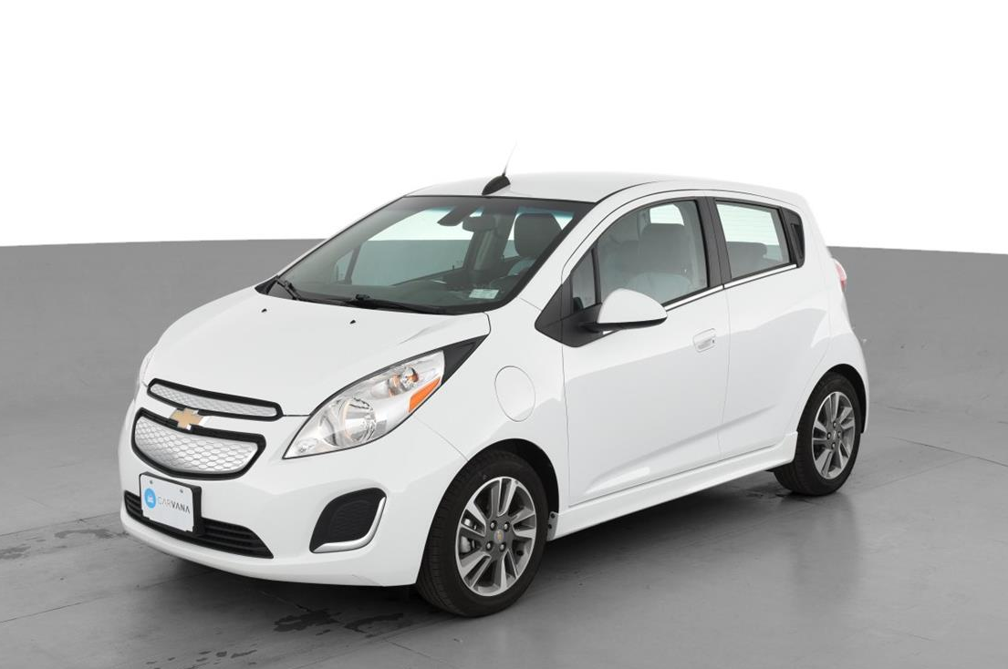
Used Plug-In Vehicles Are Affordable
2015 Chevrolet Spark EV $10,100 Mileage: 30,482 miles or $176/mo (72 mo @ 7.74%)
82 mile EV range, 140 HP

Slide 33
Used Plug-In Vehicles Are Affordable
2016 Kia Soul EV $11,198 Mileage: 23,328 miles or $209/mo (72 mo @ 7.74%)
93 mile EV range, 109 HP

Slide 34
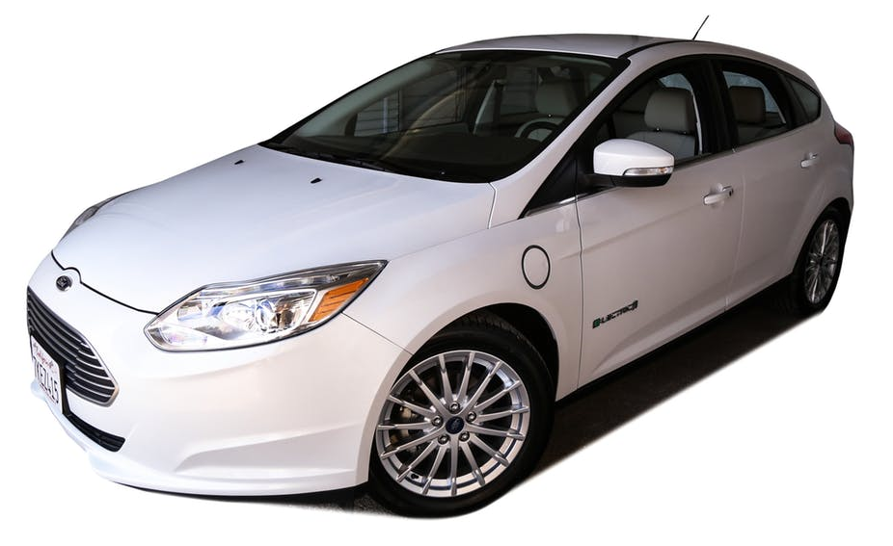
Used Plug-In Vehicles Are Affordable
2015 Ford Focus Electric $11,650 Mileage: 11,499 miles or $203/mo (72 mo @ 7.74%)
76 mile EV range, 143 HP

Slide 35
Used Plug-In Vehicles Are Affordable
2015 Ford C-Max Energi $11,690 Mileage: 88,268 miles or $203/mo (72 mo @ 7.74%)
20 mile EV range, 188 HP + Gas Engine

Slide 36
Used Plug-In Vehicles Are Affordable
2014 Ford Fusion Energi $11,925 Mileage: 58,051 miles or $208/mo (72 mo @ 7.74%)
20 mile EV range, 188 HP + Gas Engine

Slide 37
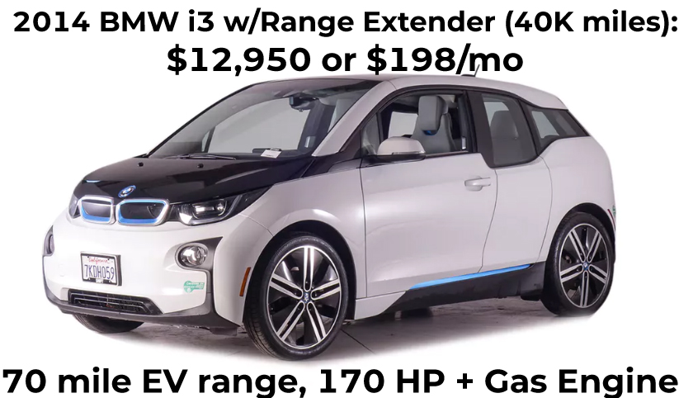
Used Plug-In Vehicles Are Affordable

Slide 38
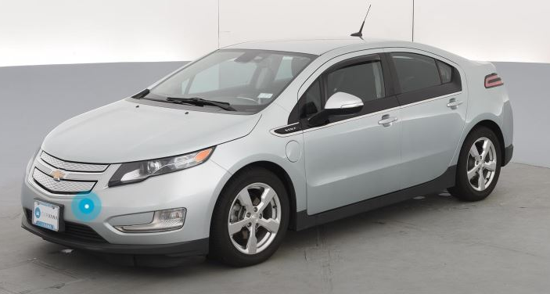
Used Plug-In Vehicles Are Affordable
2013 Chevrolet Volt $13,200 Mileage: 54,746 miles or $230/mo (72 mo @ 7.74%)
38 mile EV range, 149 HP + Gas Engine

Slide 39
Used Plug-In Vehicles Are Affordable
2016 Volkswagen e-Golf $13,600 Mileage: 32,703 miles or $237/mo (72 mo @ 7.74%)
83 mile EV range, 115 HP

Slide 40
Used Plug-In Vehicles Are Affordable
2015 Mercedes-Benz B-Class electric drive $15,998 Mileage: 45,000 miles or $278/mo (72 mo @ 7.74%)
87 mile EV range, 177 HP

Slide 41
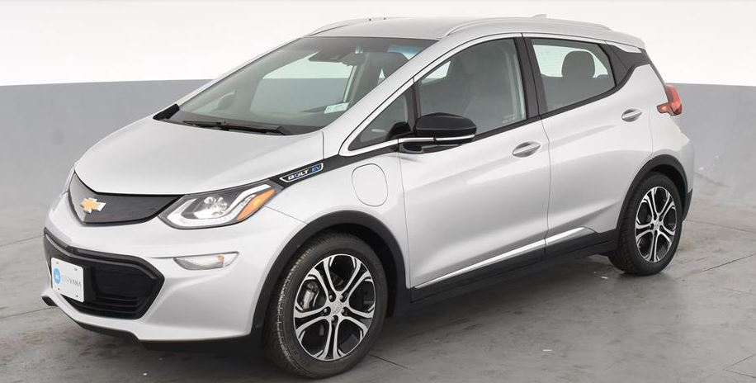
Used Plug-In Vehicles Are Affordable
2017 Chevrolet Bolt EV $21,200 Mileage: 68,977 miles or $369/mo (72 mo @ 7.74%)
238 mile EV range, 200 HP

Slide 42
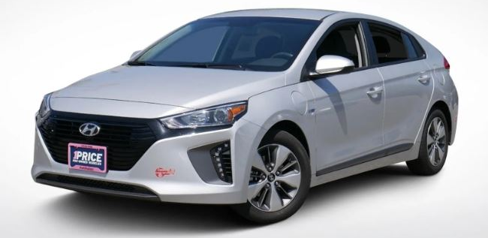
Used Plug-In Vehicles Are Affordable
2018 Hyundai Ioniq Plug-In Hybrid $21,459 Mileage: 3,780 miles or $374/mo (72 mo @ 7.74%)
29 mile EV range, 139 HP + Gas Engine

Slide 43
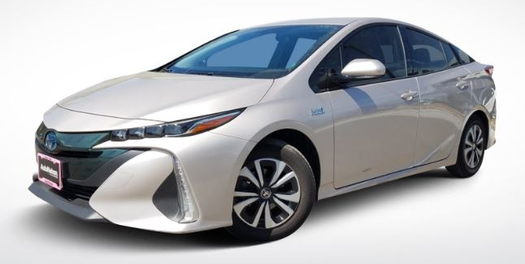
Used Plug-In Vehicles Are Affordable
2017 Toyota Prius Prime $21,999 Mileage: 30,217 miles or $383/mo (72 mo @ 7.74%)
25 mile EV range, 121 HP + Gas Engine

Slide 44
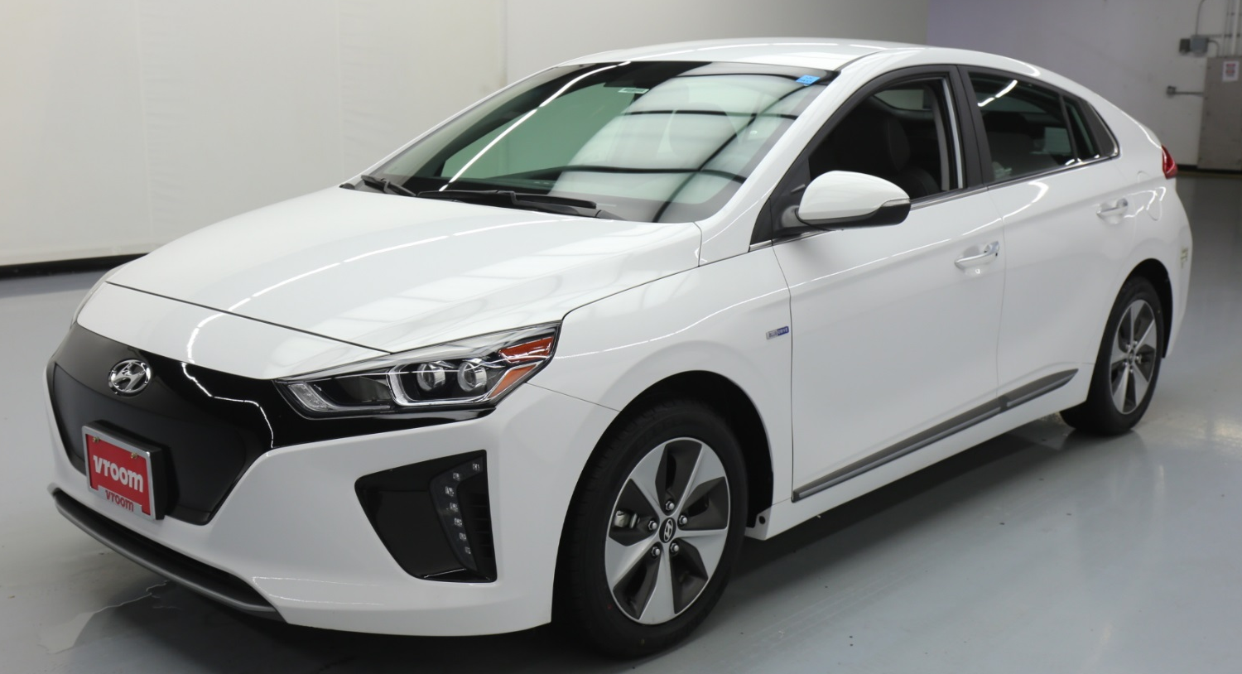
Used Plug-In Vehicles Are Affordable
2017 Hyundai Ioniq Electric $22,290 Mileage: 24,224 miles or $388/mo (72 mo @ 7.74%)
124 mile EV range, 118 HP

Slide 45
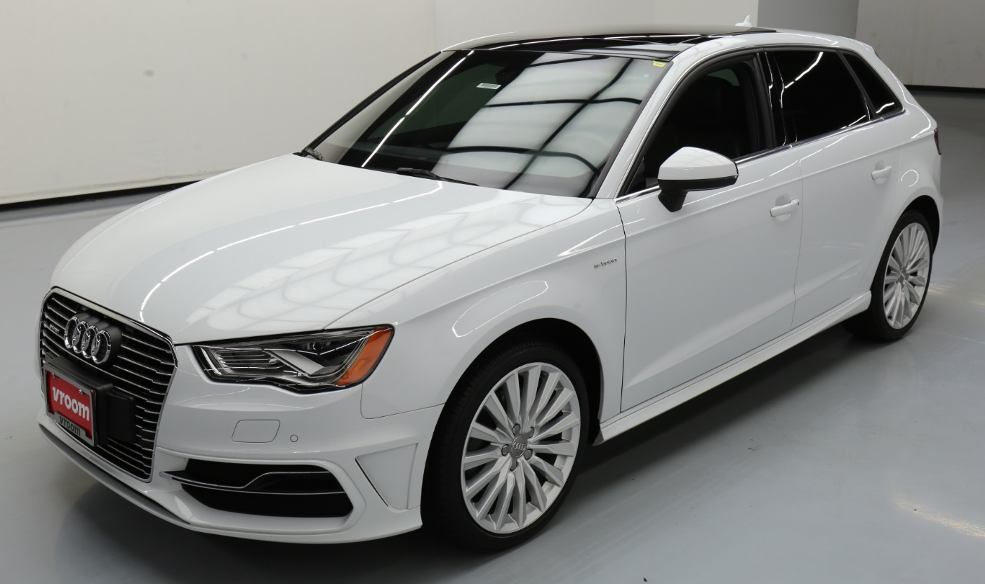
Used Plug-In Vehicles Are Affordable
2016 Audi A3 Sportback e-tron $23,650 Mileage: 45,094 miles or $412/mo (72 mo @ 7.74%)
16 mile EV range, 204 HP + Gas Engine

Slide 46
Used Plug-In Vehicles Are Affordable
2018 Honda Clarity Plug-In Hybrid $24,989 Mileage: 16,730 miles or $435/mo (72 mo @ 7.74%)
47 mile EV range, 212 HP + Gas Engine

Slide 47
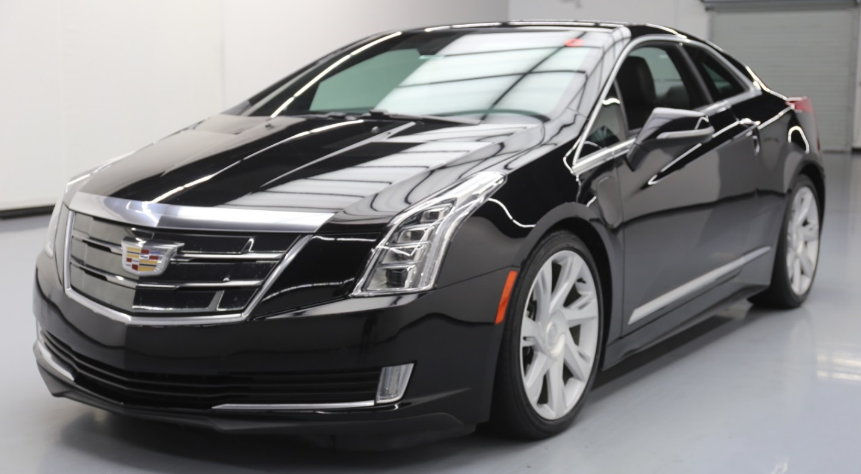
Used Plug-In Vehicles Are Affordable
2016 Cadillac ELR $32,530 Mileage: 34,232 miles or $566/mo (72 mo @ 7.74%)
35 mile EV range, 233 HP + Gas Engine

Slide 48
Used Plug-In Vehicles Are Affordable
2013 Tesla Model S $32,700 Mileage: 74,537 miles or $569/mo (72 mo @ 7.74%)
208 mile EV range, 302 HP

Slide 49
Used Plug-In Vehicles Are Affordable
2016 Volvo XC90 Hybrid $41,819 Mileage: 48,478 miles or $728/mo (72 mo @ 7.74%)
14 mile EV range, 400 HP + Gas Engine

Slide 50
Used Plug-In Vehicles Are Affordable
2018 Tesla Model 3 Long Range $42,950 Mileage: 11,193 miles or $748/mo (72 mo @ 7.74%)
310 mile EV range, 271 HP

Slide 51
Used Plug-In Vehicles Are Affordable
2017 Porsche Cayenne S E-Hybrid $54,520 Mileage: 30,627 miles or $949/mo (72 mo @ 7.74%)
14 mile EV range, 416 HP + Gas Engine

Slide 52
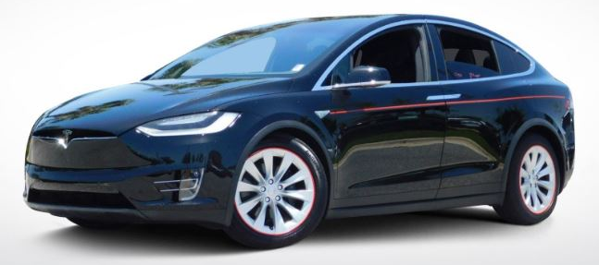
Used Plug-In Vehicles Are Affordable
2016 Tesla Model X 75D $62,999 Mileage: 25,165 miles or $1097/mo (72 mo @ 7.74%)
237 mile EV range, 518 HP

Slide 53
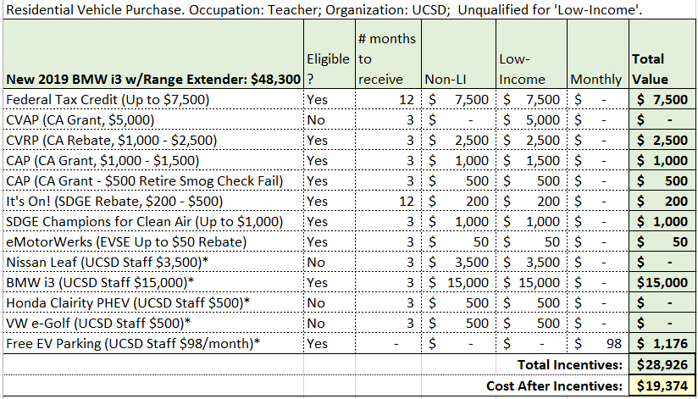
Case Study: Chula Vista 4 Bedroom Home
1 late model ICE vehicle 12,500 miles/year at 25mpg.
NEW EV Example

Slide 54
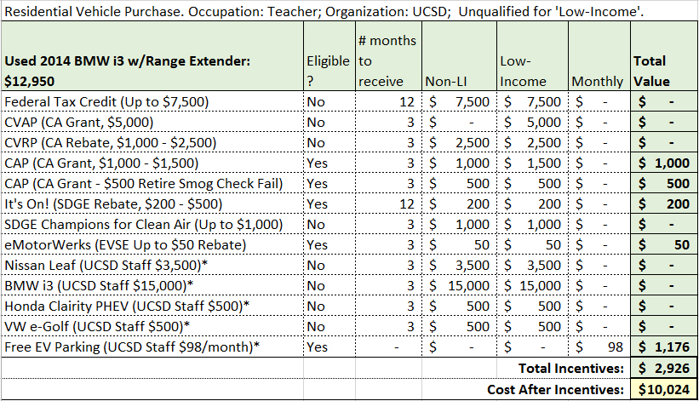
Case Study: Chula Vista 4 Bedroom Home
1 late model ICE vehicle 12,500 miles/year at 25mpg.
USED EV Example

Slide 55
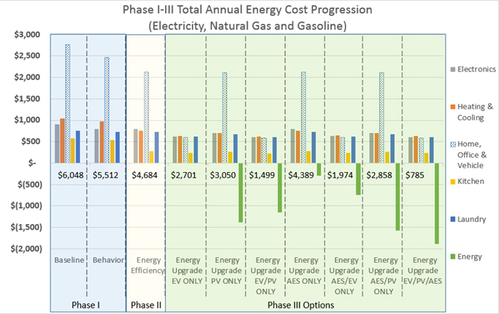
Case Study: Chula Vista 4 Bedroom Home
1 late model ICE vehicle 12,500 miles/year at 25mpg.
Phase 3 Options: 1 EV, 3.015kW DC solar, 10kWh AES (Advanced Energy Storage)

Slide 56
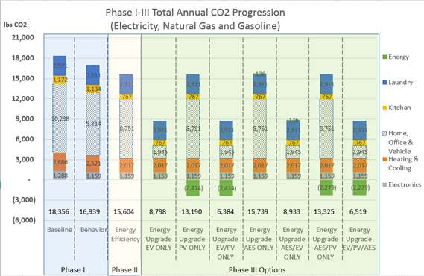
Case Study: Chula Vista 4 Bedroom Home
1 late model ICE vehicle 12,500 miles/year at 25mpg.
Phase 3 Options: 1 EV, 3.015kW DC solar, 10kWh AES (Advanced Energy Storage)

Slide 57
What to Know About Plug-In Vehicles
For more information on Solar Power, Plug-In Vehicles and Energy Storage, or to request an Energy Analysis, contact:
Charlie Q Johnson
(760) 230-3788
charlie@makello.com.

